Slide 1
Capstone Engagement
Assessment, Analysis, and Hardening of a Vulnerable System

Slide 2
Table of Contents
This document contains the following sections:
01
Network Topology
02
Red Team: Security Assessment
03
Blue Team: Log Analysis and Attack Characterization
Hardening: Proposed Alarms and Mitigation Strategies
04

Slide 3
Network Topology
3

Slide 4
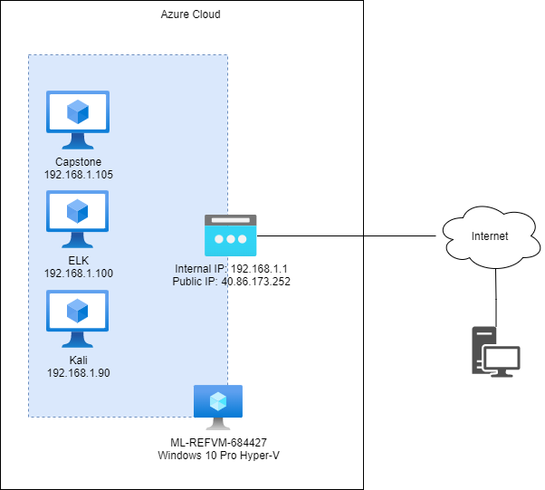
Network Topology
Network
Address Range: 192.168.1.0/24
Netmask: 255.255.255.0
Gateway:192.168.1.1
Machines
IPv4: 192.168.1.105
OS: Ubuntu Linux
Hostname: Server1
IPv4: 192.168.1.100
OS: Ubuntu Linux
Hostname: ELK
IPv4: 192.168.1.90
OS: Kali Linux
Hostname: Kali
IPv4: 192.168.1.
OS: Windows 10 Pro
Hostname: ML-REFVM-684427

Slide 5

Red Team
Security Assessment
5

Slide 6
Recon: Describing the Target
Nmap identified the following hosts on the network:
Hostname | IP Address | Role on Network
ML-RefVm-684427 | 192.168.1.1 | Hyper-V / Host
ELK | 192.168.1.100 | Elastic Logstash and Kibana server
Server1 | 192.168.1.105 | Web Server
Kali | 192.168.1.90 | Attacking Machine

Slide 7
Vulnerability Assessment
The assessment uncovered the following critical vulnerabilities in the target:
Vulnerability | Description | Impact
Web DAV remote code execution - CVE-2004-0398 (?) | Via Web DAV a bad actor can upload malicious files and remotely execute them. | Execute arbitrary code uploaded to the server, potentially obtaining a remote shell.
Unsecured login - Ryan | The user Ryan has remote access to ssh into the server. | Ryan or anyone who obtains his login credentials can access the server.

Slide 8
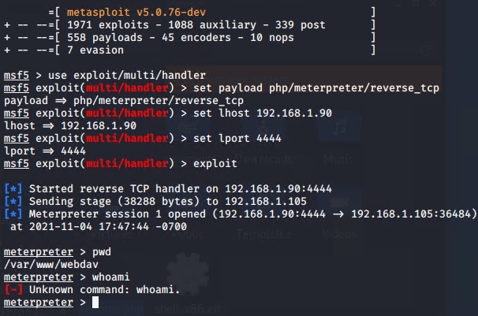
Exploitation: Web Dav
01
02
03
Tools & Processes
Scanned the network with nmap.
Located a web server and browsed to see web pages/files.
Encountered a password protected directory and discovered the password via brute force with hydra
Using information discovered in the directory, connected to the webdav share with the user credentials (password hash cracked with Crack Station)
Created a reverse shell php payload with msfvenom and delivered / executed it via the webdav share
Achievements
Was able to obtain a shell.

Slide 9
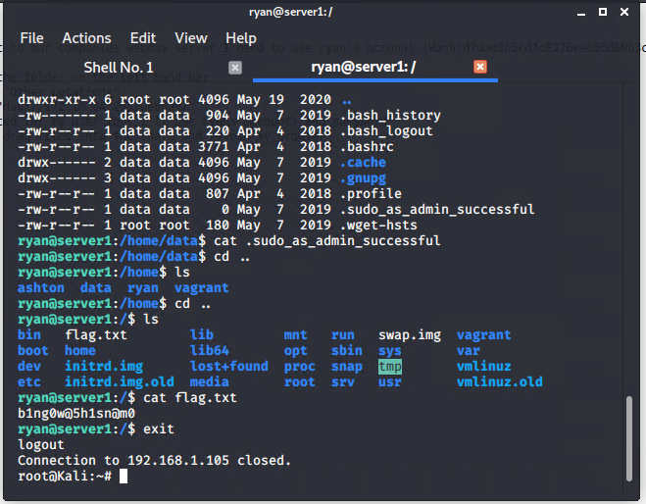
Exploitation: Login as Ryan
01
02
03
Tools & Processes
Used the user account password obtained during investigation to login to the server.
The password hash was discovered in http://192.168.1.105/companyfolders/secret_folder/connect_to_corp_cerver and cracked using Crack Station.
Achievements
Able to SSH into the machine as the user Ryan.

Slide 10

Blue Team
Log Analysis and Attack Characterization
10

Slide 11
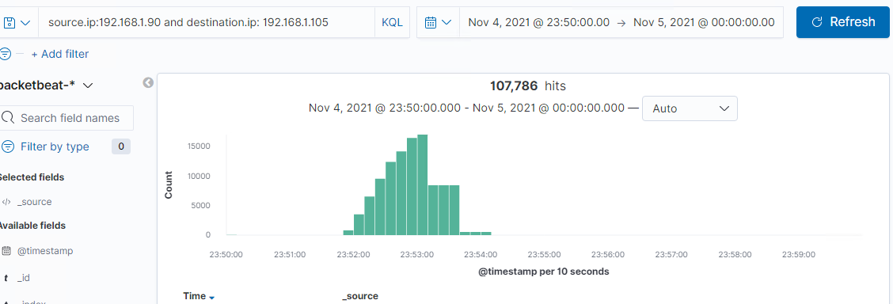
Analysis: Identifying the Port Scan
The port scan started at 23:51:50.
107,786 packets were sent from 192.168.1.90.
The indication that this is a port scan is the volume of non HTTP traffic from a single IP address going to several destination ports in quick succession

Slide 12
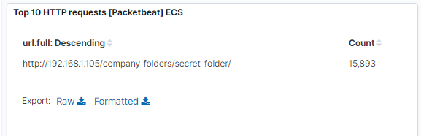
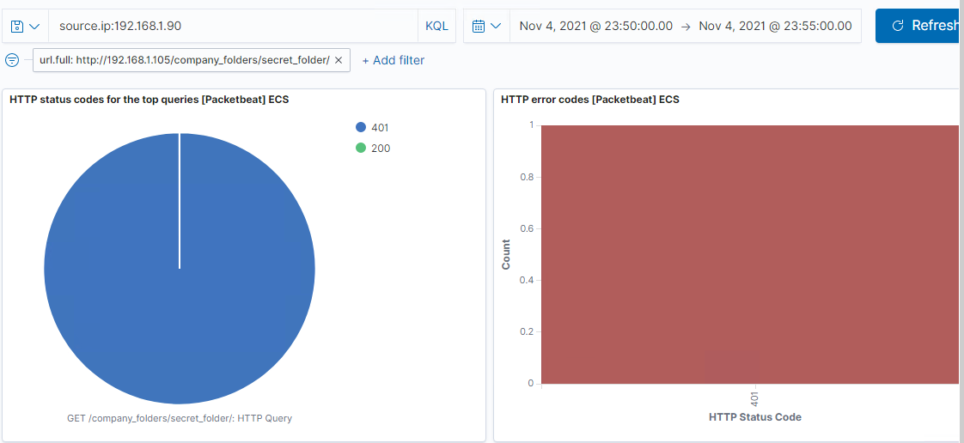
Analysis: Finding the Request for the Hidden Directory
The requests for the hidden directory were made starting at 23:51:56 . There were 15,893 requests made.
The requested file was “connect_to_corp_server”

Slide 13
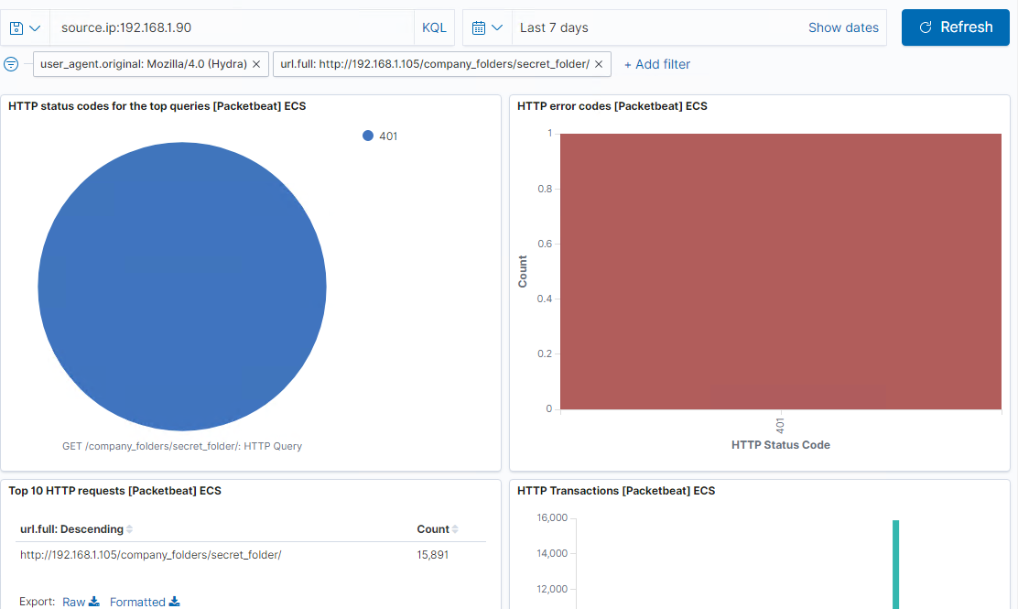
Analysis: Uncovering the Brute Force Attack
There were 15,893 requests made in the attack and 15,891 of them were made before the attacker discovered the password.

Slide 14
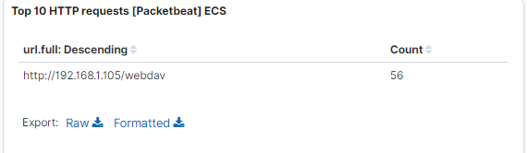
Analysis: Finding the WebDAV Connection
56 requests were made to this directory.
There were two files requested:
passwd.dav
readme.php

Slide 15
Blue Team
Proposed Alarms and Mitigation Strategies
15

Slide 16
Mitigation: Blocking the Port Scan
What kind of alarm can be set to detect future port scans?
A rule can be created to detect several packets to different destination ports from the same source address within a short period of time.
What threshold would you set to activate this alarm?
Over 20 requests in a minute.
What configurations can be set on the host to mitigate port scans?
Disable any unused services
Disable ICMP echo and echo reply
Configure an alert in the IPS to notify of an reconnaissance attack
Describe the solution. If possible, provide required command lines.

Slide 17
Mitigation: Finding the Request for the Hidden Directory
What kind of alarm can be set to detect future unauthorized access?
An alarm can be created to notify if an excessive amount of 404 errors are occurring.
What threshold would you set to activate this alarm?
Over 20 per minute.
What configuration can be set on the host to block unwanted access?
Describe the solution. If possible, provide required command lines.

Slide 18
Mitigation: Preventing Brute Force Attacks
Monitor for traffic from ‘Hydra’
This can be used to alert if someone is attempting a brute force attack with this specific tool.
Set an account lockout policy to ensure the accounts are locked temporarily after the desired number of failed login attempts
Example - account lockout on Ubuntu for SSH
sudo vi /etc/pam.d/common-auth
Add the following line, and save:
auth required pam_tally2.so onerr=fail deny=3 unlock_time=600 audit Restart the sshd service
sudo systemctl restart sshd
What kind of alarm can be set to detect future brute force attacks?
An alert can be created to monitor the number of 401s occurring.
What threshold would you set to activate this alarm?
Greater than 20 per minute.

Slide 19
Mitigation: Detecting the WebDAV Connection
What kind of alarm can be set to detect future access to this directory?
A rule can be created to alert when the specific URL is accessed and the response code indicates success
What threshold would you set to activate this alarm?
To detect any access I’d set the threshold at > 0.
What configuration can be set on the host to control access?
Enable two-factor authentication for WebDAV
Use HTTPs
Describe the solution. If possible, provide the required command line(s).
Configure Apache to use a third party tool for two factor authentication and secure the site with SSL.
Reference: https://www.howtoforge.com/webdav_with_ssl_and_two_factor_authentication_p2

Slide 20
Mitigation: Identifying Reverse Shell Uploads
What kind of alarm can be set to detect future file uploads?
Trigger an alarm when a put request is initiated in the desired directory.
What threshold would you set to activate this alarm?
Alert on 1 or more if we want to know about all uploads.
What configuration can be set on the host to block file uploads?
Restrict uploads in web server (eg configure LimitRequestBody in Apache to a reasonably low value)
Configure an IPS to block suspicious files
Describe the solution. If possible, provide the required command line.

